Slide 1

SCIENTIFIC VARIABLES
We will compare controlled, dependent and independent variables in experiments
Notes:
Insert cover image and use transparency settings to fade image.

Slide 2
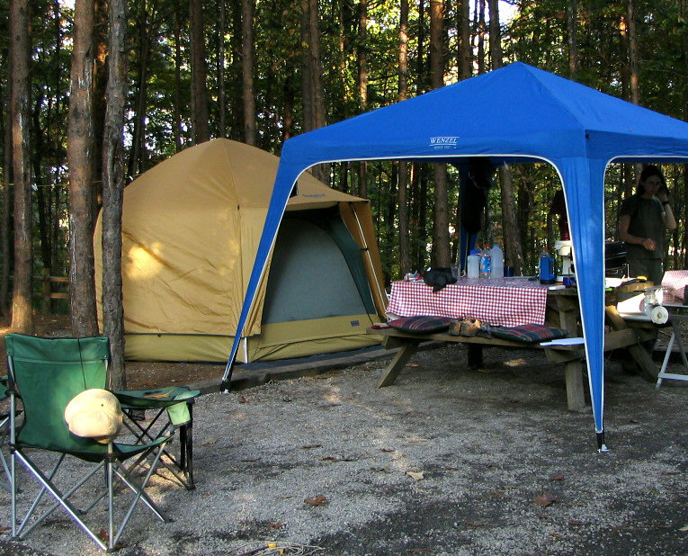
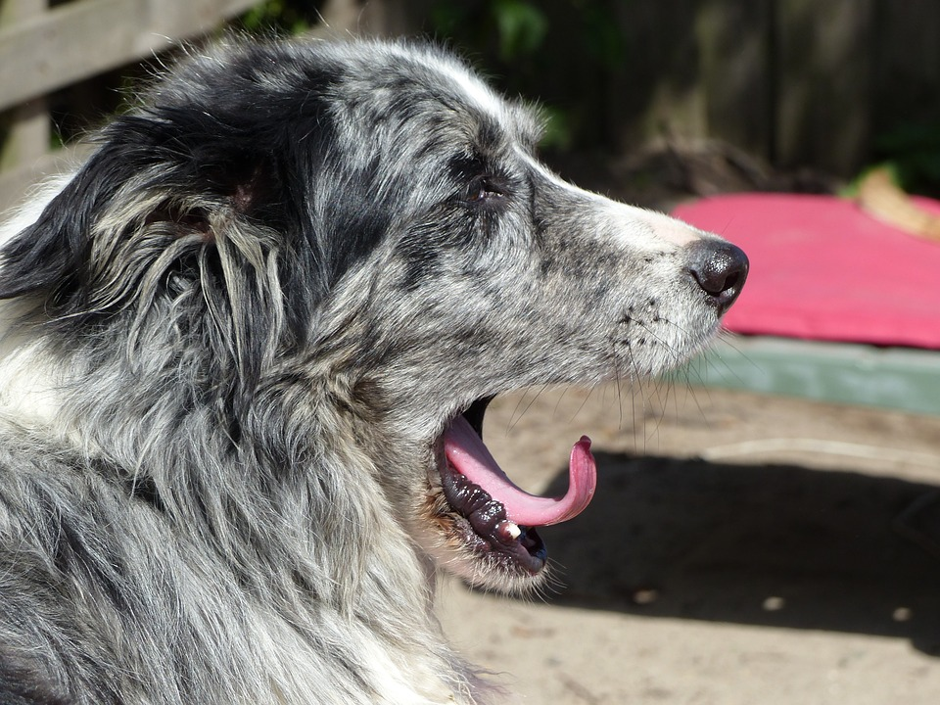
Using the pictures, what are some observations?
Using the pictures, what are some inferences?

Slide 3
Repeat the opposite word/phrase.
LABORATORY
ROOM FOR SCIENCE

Slide 4
Repeat the opposite word/phrase.
SUMMARISE
WRITE THE MAIN IDEAS

Slide 5
Repeat the opposite word/phrase.
NORM
WAY OF DOING THINGS

Slide 6
Repeat the opposite word/phrase.
OBSERVATION
WE USE OUR SENSES

Slide 7
Repeat the opposite word/phrase.
INFERENCE
WHAT WE THINK IS HAPPENING

Slide 8
We will compare₁ variables in experiments
TRACK WITH ME
READ WITH ME
We will define variable.
We will compare controlled, dependent and independent variables.
VOCABULARY
1 - Look at the differences
DECLARE THE OBJECTIVE
Read the learning objective to your partner.
Notes:
Learning Objectives contain concepts (nouns, big ideas), skills (verbs, measurable behaviours) and sometimes context (restricting or targeting conditions).
●Example: Students will be able to describe the concept of density and apply it to floating and sinking.
●
Success criteria are specific measurable outcomes that if met mean that the student has met the learning objective.
Examples:
•Students will be able to compare densities of substances using mass and volume.
•Students will be able to identify whether a solid or liquid will float or sink in a liquid based on their densities.

Slide 9

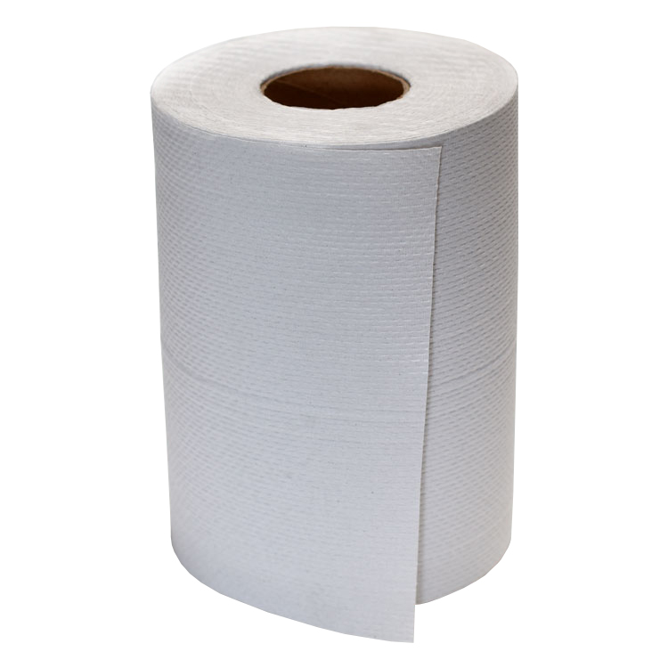
We will compare variables in experiments
10 minutes
Will a brand name paper towel absorb more water than a generic paper towel?
_{We have these materials:} _{- 250ml of water} _{- measuring cylinder} _{- tin pan}
How would answer this question?
Notes:
250ml of water

Slide 10
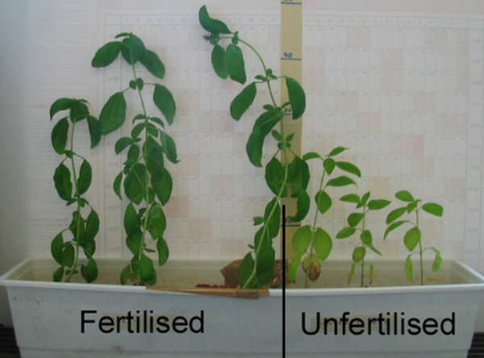
We will compare variables in experiments
CHECK FOR UNDERSTANDING
What are some variables in this experiment? Pair-Share
Scientists do experiments₁.
A variable₂ is anything that can change the result of an experiment.
For example:
Scientist can experiment whether plants grow better by variables such as type of plant, soil type or fertiliser.
VOCABULARY
1 - A series of steps to test something in science 2 - anything that can change the result of an experiment

Slide 11
We will compare variables in experiments
TRACK WITH ME
Variables₁ are grouped into three different types.
READ WITH ME
Type of Variable | Definition
Independent Variable | Only one variable that is changed on purpose in the experiment₂.
Dependent Variable | What is measured and what changes because of the independent variable.
Controlled Variables | All variables that are kept the same in an experiment₂.
CHECK FOR UNDERSTANDING
How many variables are there? What variable do we change on purpose in an experiment? What variables are kept the same? Pair-Share
VOCABULARY
1 - anything that can change the result of an experiment 2 - A series of steps to test something in science

Slide 12
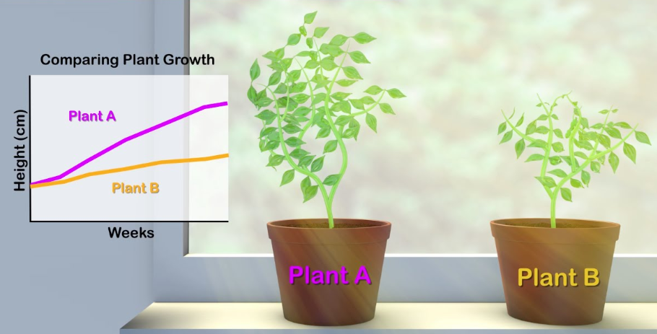
We will compare variables in experiments
HINT
Students, remember that variables are grouped into 3 different types. Independent: Only one variable that is changed on purpose in the experiment. Dependent: What is measured and what changes because of the independent variable. Controlled: All variables that are kept the same in an experiment.
Let’s practice applying the types of variables to examples of experiments.
In this experiment, fertiliser was added to Plant A but not Plant B. The height of the plant was measured to see what change the fertiliser made.
What is the independent variable?
What is the dependent variable?
What would be two controlled variables?
CHECK FOR UNDERSTANDING
What is the difference between the independent variable and the dependent variable? Pair-Share

Slide 13
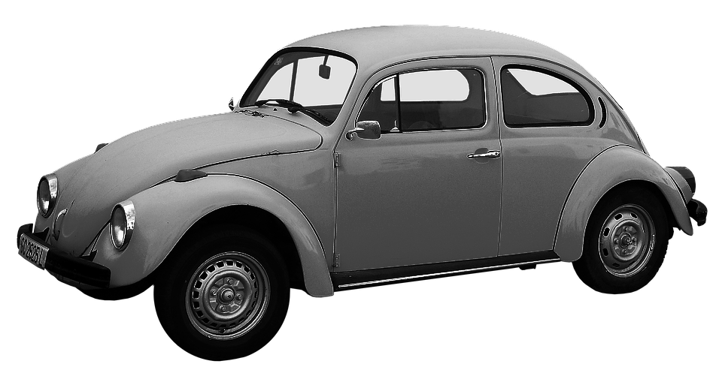
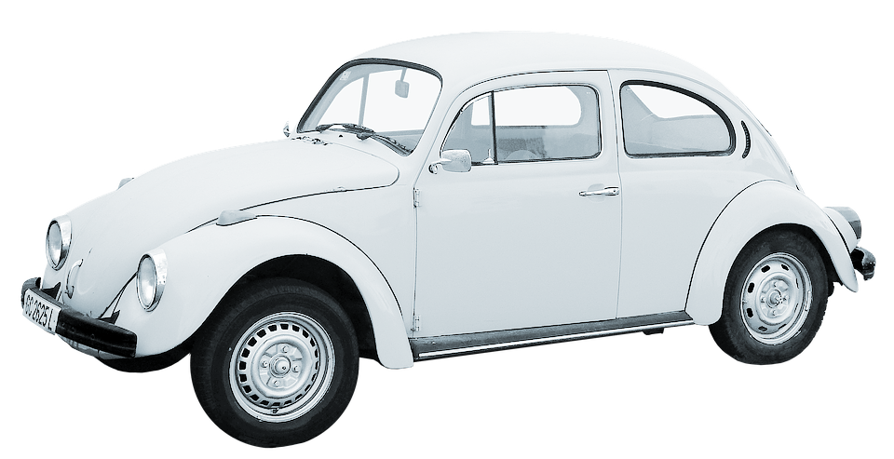
We will compare variables in experiments
HINT
Students, remember that variables are grouped into 3 different types. Independent: Only one variable that is changed on purpose in the experiment. Dependent: What is measured and what changes because of the independent variable. Controlled: All variables that are kept the same in an experiment.
Let’s practice applying the types of variables to examples of experiments.
In this experiment, a grey car and a white car were parked in the sun. The temperature of each car was measured throughout the day to see which colour would heat up faster.
What is the independent variable?
What is the dependent variable?
What would be two controlled variables?
CHECK FOR UNDERSTANDING
What is the difference between the independent variable and controlled variables? Pair-Share

Slide 14
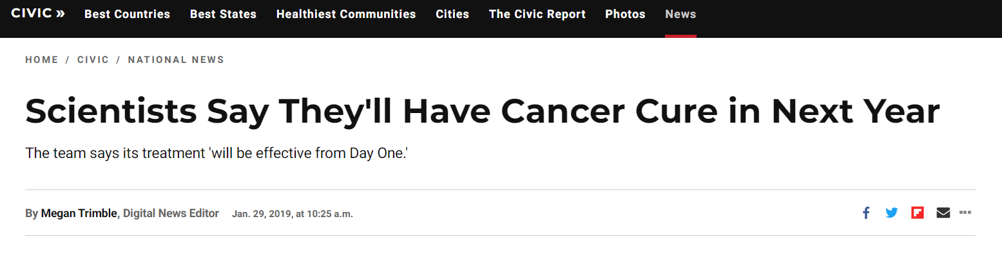
We will compare variables in experiments
An experiment is not fair if it does not follow the above variables. The experiment will not be valid₁.
This is important if you are trying to design an experiment to cure a disease or discover a new area of science.
You must be able to show each step of your experiment for it to be taken seriously.
CHECK FOR UNDERSTANDING
Why are variables important in an experiment? Pair-Share
VOCABULARY
1 - acceptable

Slide 15
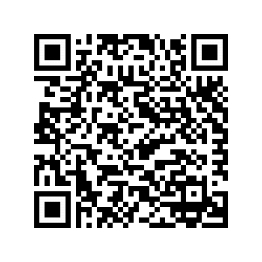
We will compare variables in experiments
3 minutes
Apply the types of variables to the example below of an experiment.
In this experiment, students are increasing the temperature of the water in a beaker on purpose to see if more tablespoons of salt will dissolve in different temperatures. One is 15°C one is 50°C and one is 100°C.
Using full sentences answer the following questions:
List 4 control variables for this experiment.
Identify the independent variable.
Identify the dependent variable.
EXTENSION
Notes:
Please include tasks/questions here rather than just referring to a worksheet. This will save on photocopying and facilitate sharing with other schools.
Try and build tasks/questions which escalate through Bloom’s Taxonomy. This will help with differentiation.

Slide 16
We will compare₁ controlled, dependent and independent variables in experiments
TRACK WITH ME
READ WITH ME
We will define variable.
We will compare controlled, dependent and independent variables.
VOCABULARY
1 - Look at the differences
CHECK FOR UNDERSTANDING
Check Success Criteria.
Notes:
Learning Objectives contain concepts (nouns, big ideas), skills (verbs, measurable behaviours) and sometimes context (restricting or targeting conditions).
●Example: Students will be able to describe the concept of density and apply it to floating and sinking.
●
Success criteria are specific measurable outcomes that if met mean that the student has met the learning objective.
Examples:
•Students will be able to compare densities of substances using mass and volume.
•Students will be able to identify whether a solid or liquid will float or sink in a liquid based on their densities.

